Slide 1

Wireless Charging of electric vehicles

Slide 2
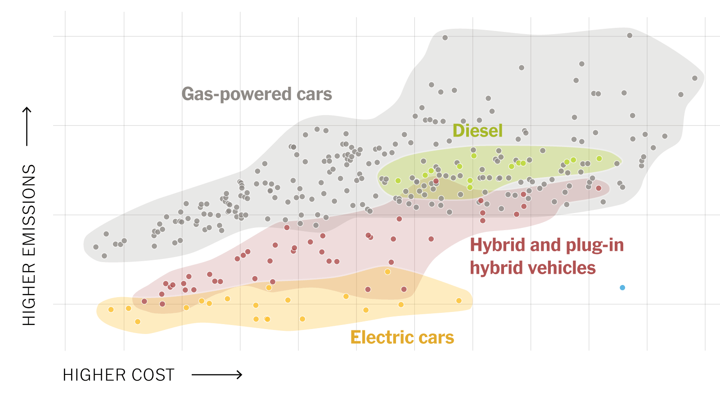
Electric vehicles are the future of transportation, they are more environmentally friendly, cheaper to operate, and increasingly more practical and convenient for everyday use.

Slide 3
One major drawback that electric vehicles have over normal vehicles is the limited driving range and the need for recharging, which can take longer than refueling a conventional vehicle with gasoline or diesel.
Static and dynamic wireless charging can be used to address the limited driving range of electric vehicles.

Slide 4
PROBLEMS AND THEIR EXISITING ALERNATIVES:
SOLUTIONS:
VALUE
PROPOSITION
AND ANALOGY:
UNFAIR
ADVANTAGES AND
CHANNELS:
CUSTOMER
SEGMENTS AND
ADOPTERS:
1.Electric car charging faces problems of limited driving range and long charging time.
2. Existing alternatives include public and home charging stations, battery, swapping, wireless charging, and solar charging.
3. Public charging stations are common and offer a range of charging speeds.
4. Home charging stations offer convenience but require installation.
5. Battery swapping and wireless charging are still in early stages of development
Wireless charging offers
convenience, efficiency,
durability, versatility,
safety, and aesthetics. It
is more efficient than
wired charging due to
no cables to cause
resistance or
overheating. It is
versatile and can be
used with a wide range
of devices, making it
easy to charge multiple
devices with the same
charging pad. It is safer
than traditional
charging methods due
to no cables to trip over
or get caught on
objects.
Wireless car charging is a
technology that offers
convenience and
accessibility for electric
vehicle owners. It
eliminates the need for
cables and plug-ins,
making charging more
seamless and effortless.
The value proposition is
that this technology has
the potential to increase
the adoption of electric
vehicles by making
charging more convenient
and accessible. The
analogy for wireless car
charging is similar to
wireless charging for
mobile devices, which has
become a widely adopted
technology that offers
convenience to users.
Unfair advantages:
Wireless car charging
eliminates the need for
cables and plug-ins,
offering convenience to
users. It has the potential
to increase the adoption of
electric vehicles. The
technology is
environmentally friendly
and eliminates the risk of
tripping hazards.
Challenges: Wireless car
charging technology is still
in early stages of
development and not yet
widely available. It is not as
efficient as wired charging
and can be affected by
weather conditions. The
cost of implementing the
technology can also be a
challenge
1. Early adopters of
electric vehicles who
value convenience
and ease of use.
2. Businesses with
fleets of electric
vehicles to reduce
downtime.
3. Homeowners without
a dedicated parking
space who rely on
on-street parking.
4. Public charging
stations and parking
lots.
5. Customers who
prioritize
environmentally
friendly charging
solutions.
Cost:
1. Cost of wireless car charging varies based on technology, power output, and
installation.
2. Wireless charging systems are generally more expensive than wired charging
systems.
3. As demand increases and technology advances, the cost of wireless charging
is expected to decrease.
4. Cost remains a challenge for manufacturers and consumers
Revenue sources:
1. Sales of wireless charging systems to manufacturers and consumers.
2. Subscription-based revenue models for wireless charging services in public
charging stations and parking lots.
3. Licensing agreements with other companies to use the wireless charging
technology.
4. Revenue from advertising on wireless charging pads or systems.

Slide 5



ELECTRIC CARS ARE A PROMISING DEVELOPMENT IN THE WORLD OF TRANSPORTATION, OFFERING A MORE SUSTAINABLEAND EFFICIENT WAY TO GET AROUND. THESE CARS ARE BECOMING INCREASINGLY POPULAR AS PEOPLE BECOME MORE CONCERNED ABOUT THE ENVIRONMENTAND THE IMPACT OF TRADITIONAL GASOLINE-POWERED VEHICLES ON THE PLANET.

Slide 6
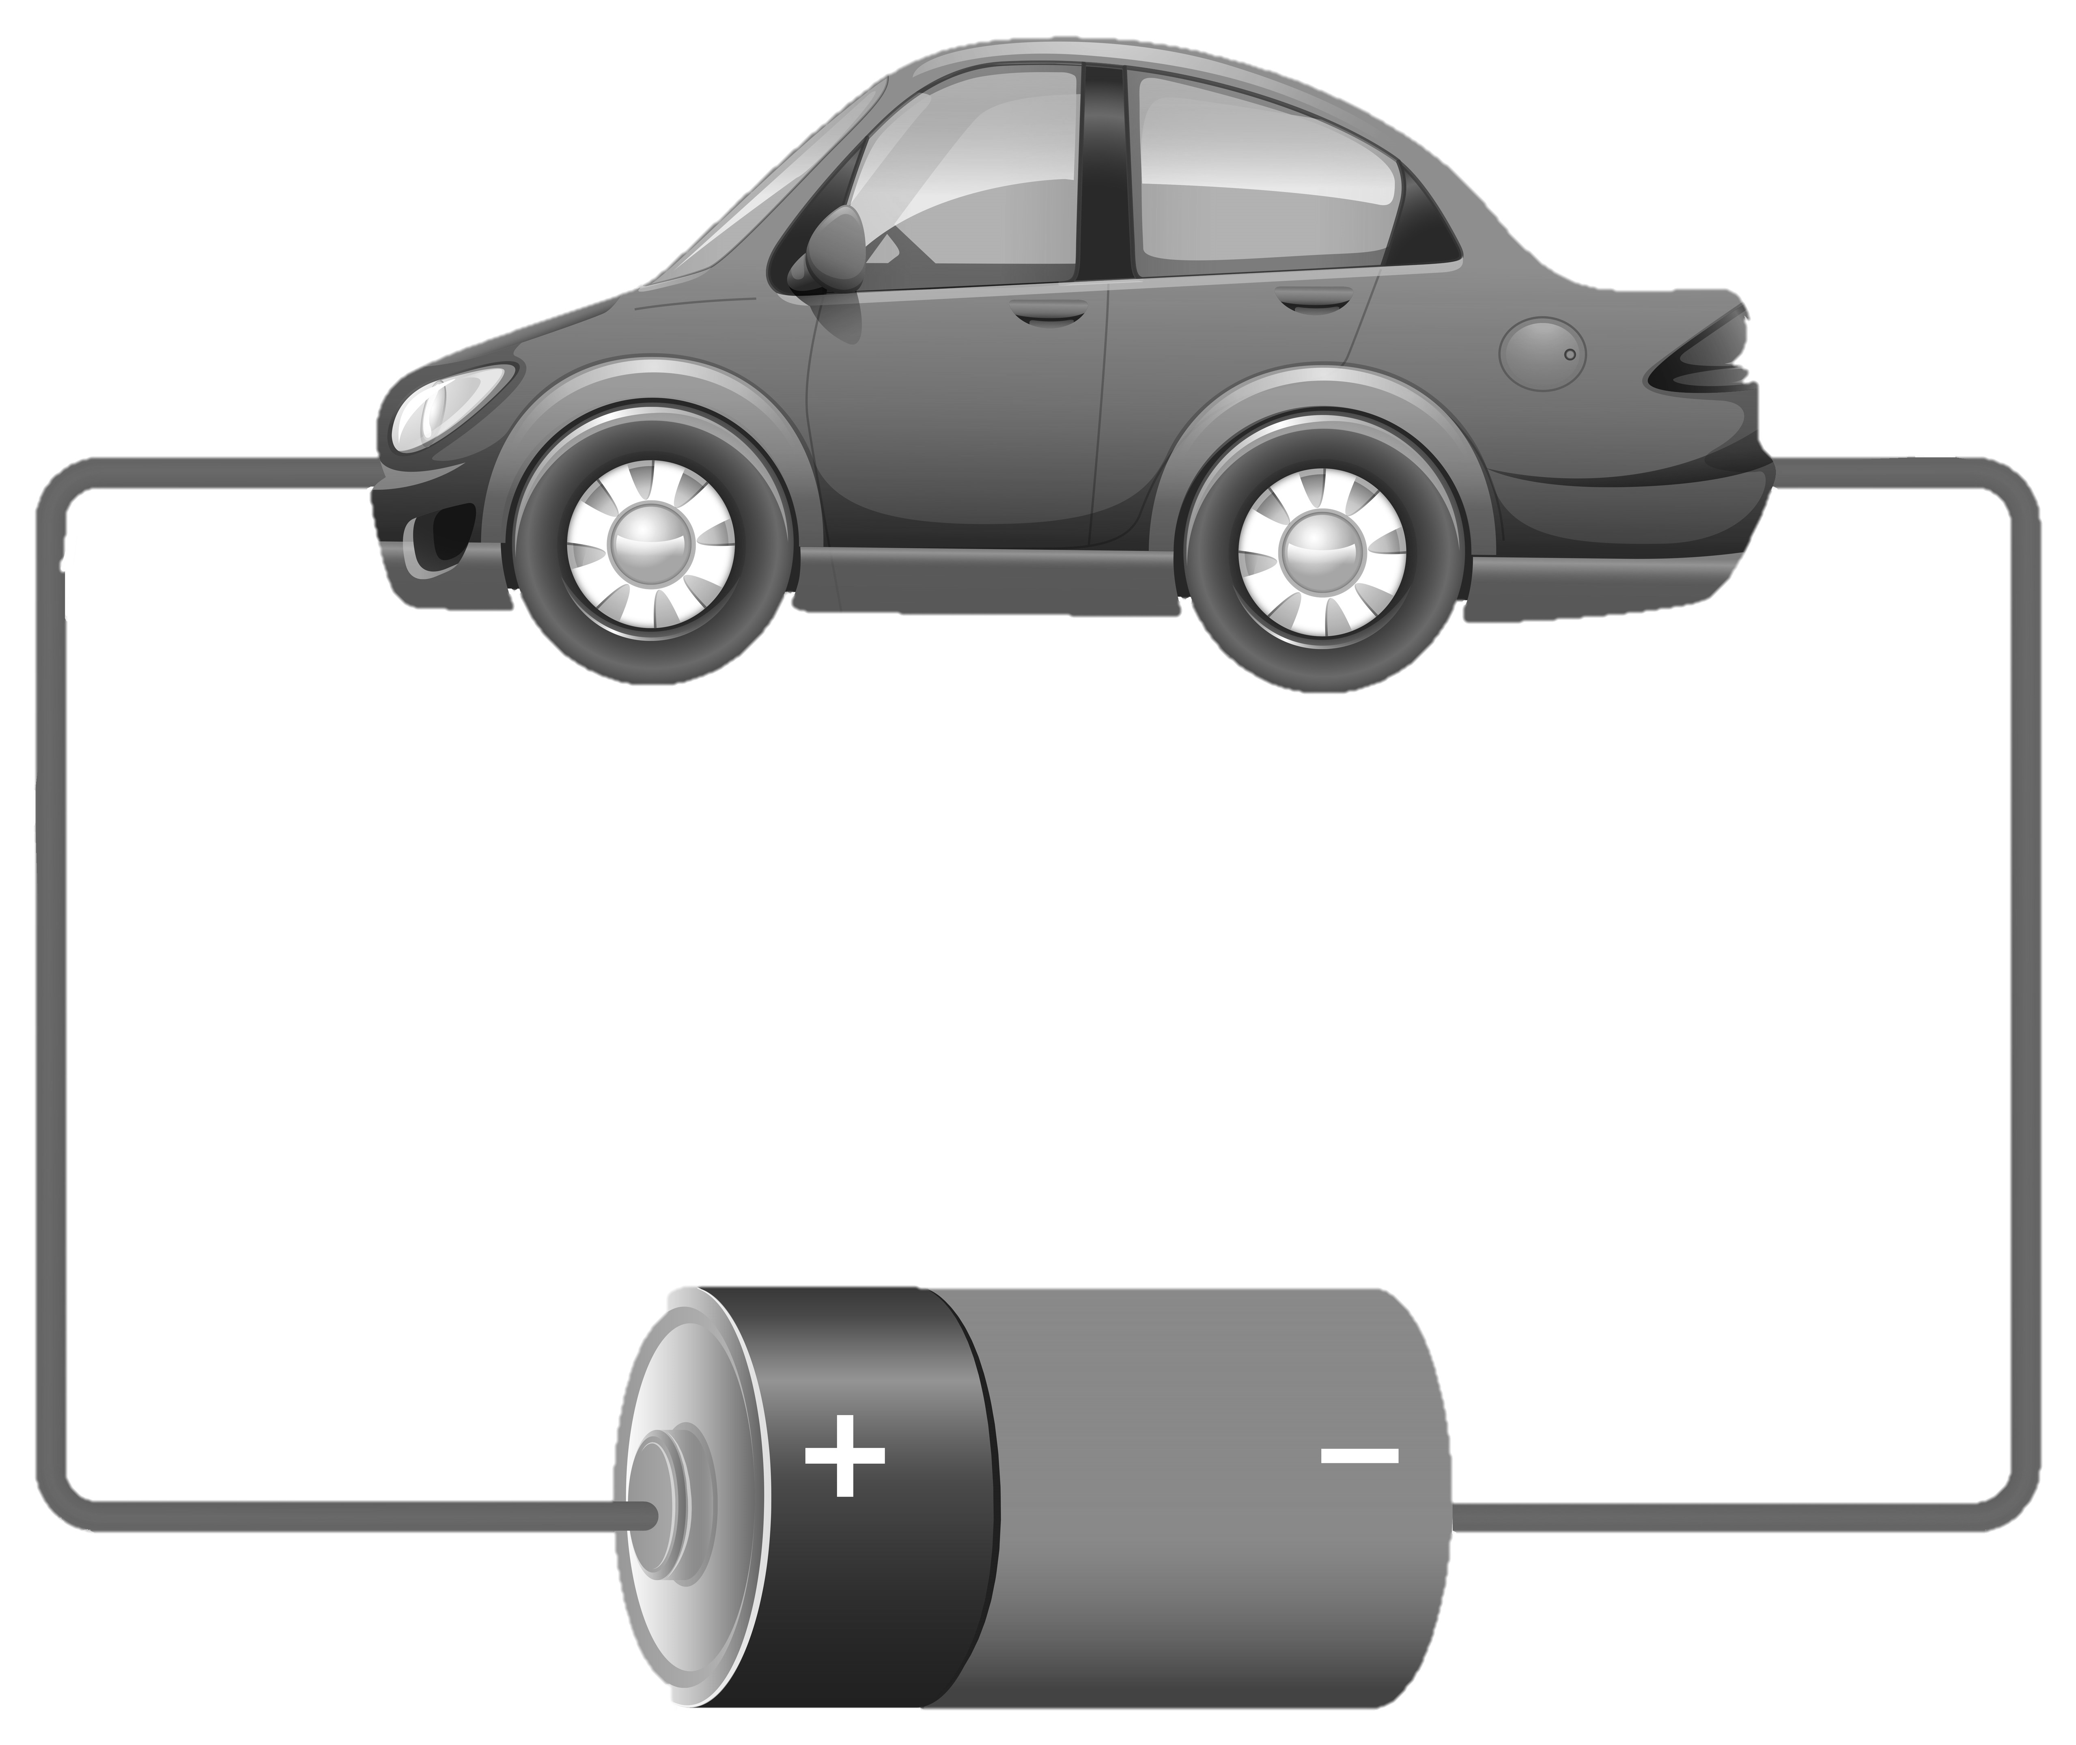
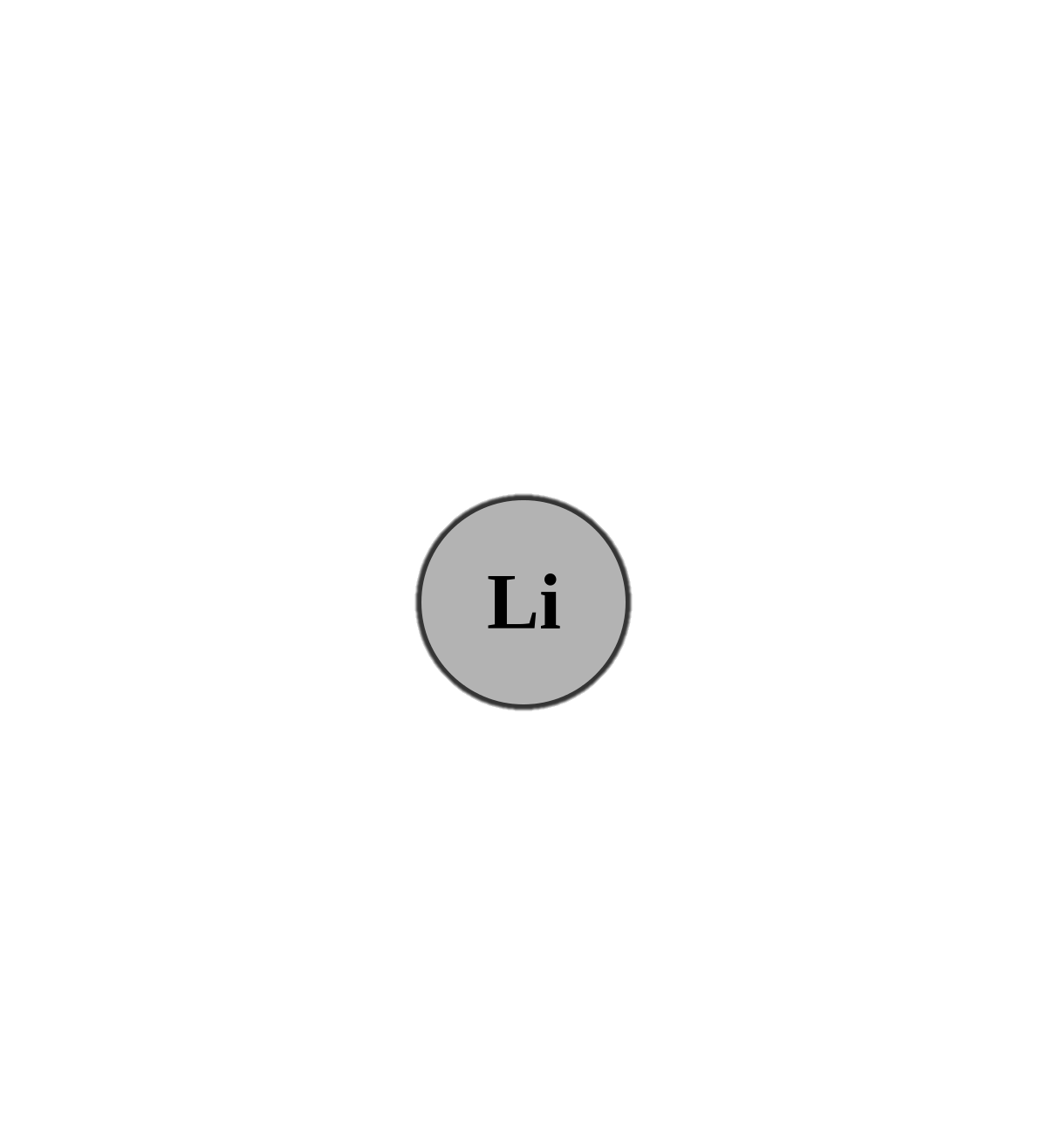
ELECTRIC CARS RELY ON BATTERIES TO STORE THE ENERGY NEEDED TO POWER THEIR ELECTRIC MOTORS. LITHIUM-IONBATTERIES ARE A POPULAR CHOICE FOR THIS APPLICATION BECAUSE THEY ARE ABLE TO STORE LARGE AMOUNTS OF ENERGY IN A RELATIVELY SMALL AND LIGHTWEIGHT PACKAGE.

Slide 7
ELECTRIC CARS RELY ON BATTERIES TO STORE THE ENERGY NEEDED TO POWER THEIR ELECTRIC MOTORS. LITHIUM-IONBATTERIES ARE A POPULAR CHOICE FOR THIS APPLICATION BECAUSE THEY ARE ABLE TO STORE LARGE AMOUNTS OF ENERGY IN A RELATIVELY SMALL AND LIGHTWEIGHT PACKAGE.

Slide 8
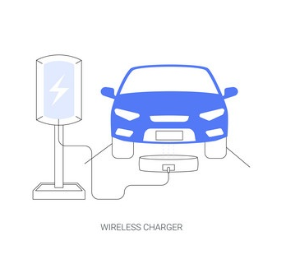
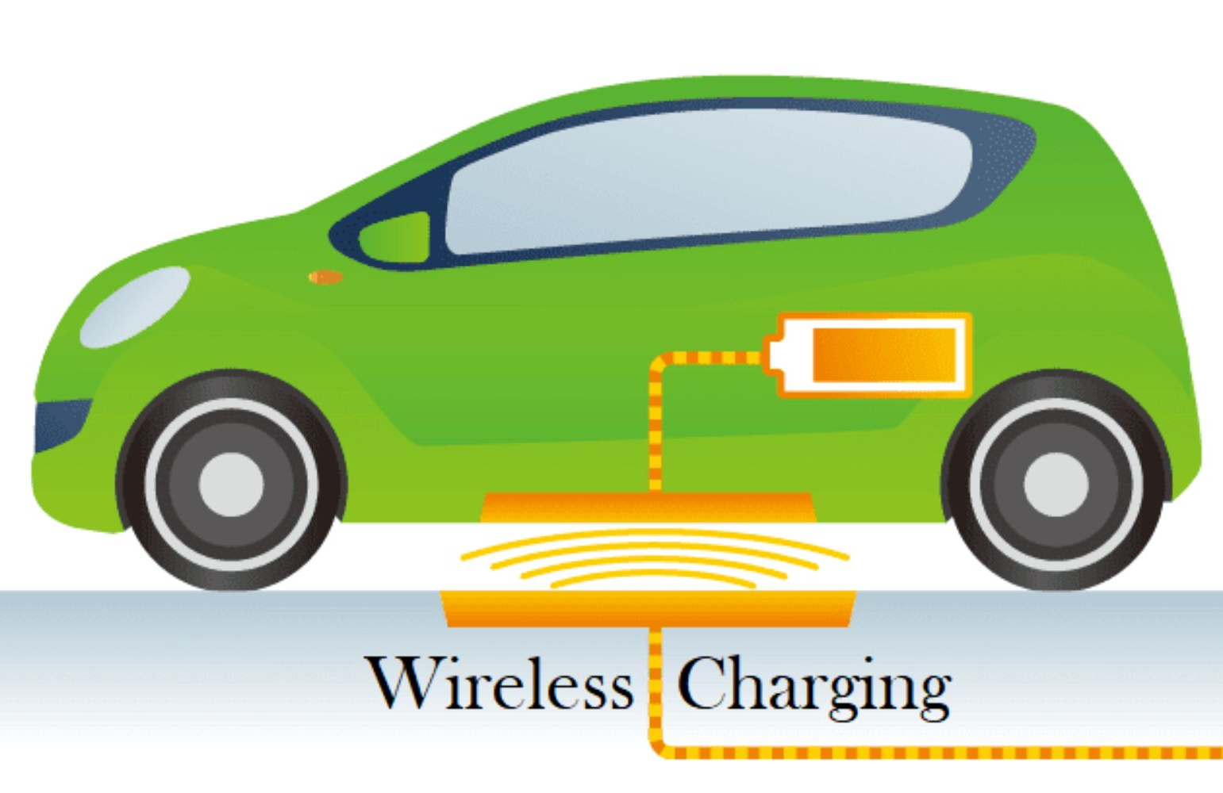
WIRELESS CHARGING OF ELECTRIC CARS IS AN INNOVATIVE TECHNOLOGY THAT AIMS TO
• SIMPLIFY THE CHARGING PROCESS
• REDUCE THE RELIANCE ON TRADITIONAL PLUG-IN CHARGING METHODS.

Slide 9
STATIC
DYNAMIC
STATIC WIRELESS CHARGING INVOLVES A STATIONARY CHARGING PAD THAT THE CAR IS PARKED ON, AND THE CHARGING PROCESS BEGINS AUTOMATICALLY.
THIS IS TECHNOLOGY THAT ALLOWS ELECTRIC VEHICLES TO CHARGE THEIR BATTERIES WIRELESSLY WHILE DRVING ON THE ROAD

Slide 10
WIRELESS CHARGING HAS SEVERAL ADVANTAGES OVER TRADITIONAL WIRED CHARGING METHODS, INCLUDING:
• CONVINIENCE
• EFFICIENCY
• DURABILITY
• VERSATILITY
• SAFETY

Slide 11
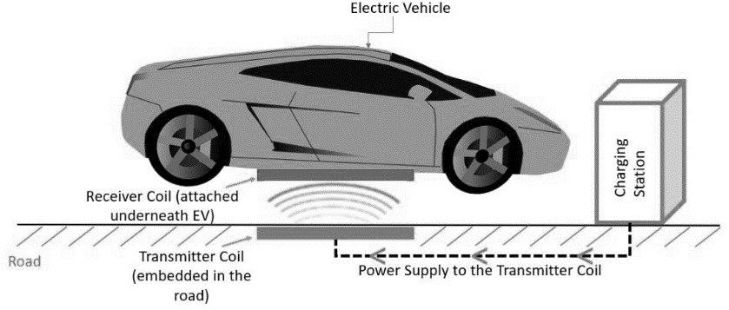
STATIC WIRELESS CHARGING SYSTEM
STATIC WIRELESS CHARGING INVOLVES A SATIONARY CHARGING PAD THAT CAR IS PARKED ON, AND THE CHARGING PROCESS BEGINS AUTOMATICALLY
THE CHARGING PAD IS CONNECTED TO A POWER SOURCE, AND THE POWER IS TRANSFERRED TO THE CAR THROUGH ELECTROMAGNETIC INDUCTION OR RESONANT INDUCTIVE COUPLING.

Slide 12
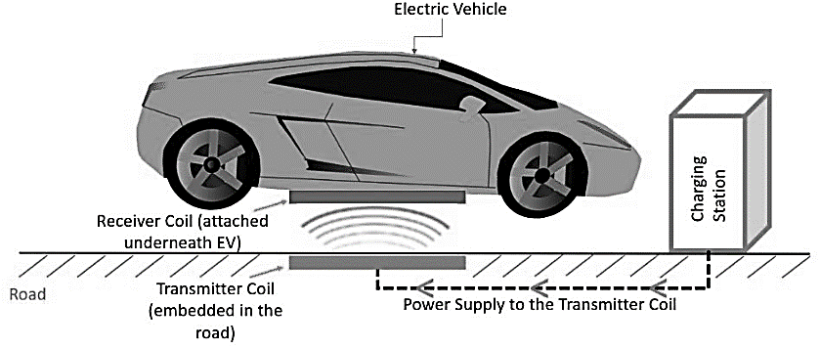

Slide 13
ELECTRIC CAR IS PARKED IN A DESIGNATED WIRELESS CHARGING SPOT.
WIRELESS CHARGING POD DETECTS THE PRESENCE OF THE CAR.
CHARGING PAD INITIATES COMMUNICATION WITH THE CAR’S ONBOARD CHARGING SYSTEM.
CAR’S CHARGING SYSTEM COMMUNICATES WITH THE CHARGING PAD TO VERIFY COMPATIBILITY AND NEGOTIATE CHARGING PARAMETERS.
ONCE PARAMETERS ARE AGREED UPON,CHARGING BEGINS.
CHARGING PAD MONITORS CHARGING PROGRESS AND ADJUSTS CHARGING RATE NECESSARY.
WHEN CHARGING IS COMPLETE,CHARGING PAD NOTIFIES CAR’S ONBOARD CHARGING SYSTEM.
CHARGING PAD STOPS CHARGING AND DISCONNETS FROM THE CAR.

Slide 14
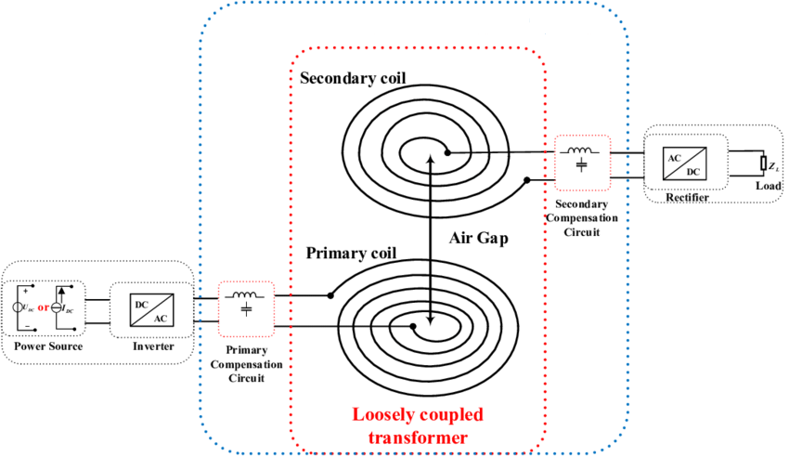
INDUCTIVE POWER TRANSFER (IPT) TECHNOLOGY IS A METHOD OF WIRELESSLY TRANSMITTING ELECTRICALPOWER OVER SHORT DISTANCES USING ELECTROMAGNETIC FIELDS. IT IS COMMONLY USED IN DEVICES SUCHAS ELECTRIC TOOTHBRUSHES, SMARTPHONES, AND EVEN ELECTRIC CARS.

Slide 15
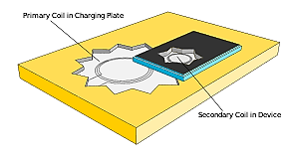
IN THE CASE OF WIRELESS CHARGING FOR ELECTRIC CARS, A CHARGING PAD IS PLACED ON THE GROUND, WHICH GENERATES A MAGNETIC FIELD. THE ELECTRIC CAR IS EQUIPPED WITH A RECEIVER COIL THAT IS POSITIONED UNDER THE CAR. WHEN THE CAR IS PARKED ON THE CHARGING PAD, THE RECEIVER COIL IS PLACED WITHIN THE MAGNETIC FIELD AND AN ELECTRICAL CURRENT IS INDUCED IN THE COIL.
THE CHARGING PAD AND THE RECEIVER COIL ARE DESIGNED TO BE EFFICIENT, SO THAT THE TRANSFER OF ENERGY BETWEEN THE TWO IS AS HIGH AS POSSIBLE.

Slide 16
TECHNOLOGIES AND RESOURCES REQUIRED TO BUILD WIRELESS CHARGING PADS FOR ECARS :
CHARGING PADS:
POWER ELECTRONICS
COMMUNICATION SYSTEM
CONTROL SOFTWARE
MATERIALS
INFRASTRUCTURE

Slide 17
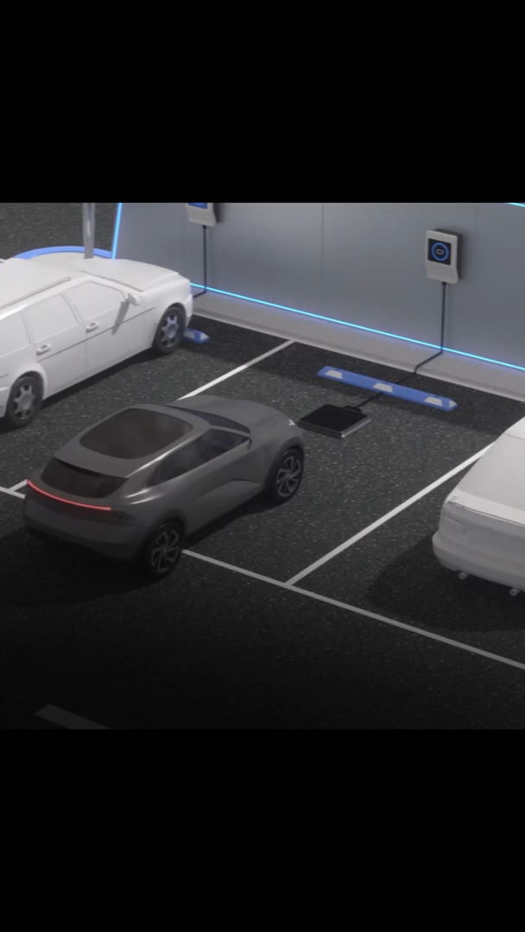
HYUNDAI AND KIA ARE CONSIDERING ON COMMERCIALIZING THE TECHNOLOGY UPON THE LAUNCH OF LEVEL 4 AUTONOMOUS VEHICLE AROUND YEAR 2025. HYUNDAI AND KIA ALSO PLAN TO COMMERCIALIZE AUTONOMOUS VEHICLES IN VARIOUS SMART CITIES FROM 2021 WITH A GOAL OF LAUNCHING FULLY AUTONOMOUS VEHICLES BY 2030.

Slide 18
DYNAMIC WIRELESS CHARGING SYSTEM

Slide 19
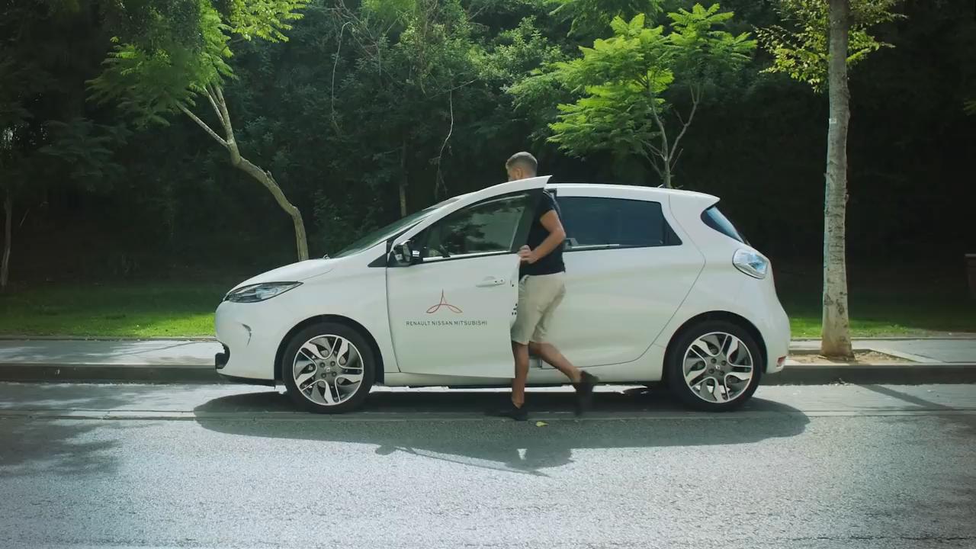
ELECTREON A LEADING PROVIDER OF WIRELESS CHARGING SOLUTIONS FOR ELECTRIC VEHICLES (EVS) AND HAS ALREADY MADE A LOT OF PROGRESS WITH DYNAMIC WIRELESS CHARGING SYSTEMS FOR ELECTRIC VEHICLES

Slide 20
DYNAMIC ELECTRIC VEHICLE CHARGING REFERS TO A SYSTEM IN WHICH ELECTRIC VEHICLES (EVS) ARE CHARGED WHILE THEY ARE IN MOTION, RATHER THAN WHILE THEY ARE PARKED AT CHARGING STATIONS. THIS IS DONE THROUGH A TECHNOLOGY CALLED WIRELESS POWER TRANSFER (WPT), WHICH USES ELECTROMAGNETIC FIELDS TO TRANSFER ENERGY BETWEEN TWO COILS - ONE ON THE ROAD AND ONE ON THE VEHICLE.
DYNAMIC CHARGING IS SEEN AS A PROMISING SOLUTION TO THE RANGE LIMITATION OF ELECTRIC VEHICLES, AS IT ALLOWS THEM TO TRAVEL LONG DISTANCES WITHOUT STOPPING FOR A PROLONGED PERIOD OF TIME TO RECHARGE THEIR BATTERIES. THIS CAN INCREASE THE PRACTICALITY AND CONVENIENCE OF ELECTRIC VEHICLES, MAKING THEM MORE APPEALING TO CONSUMERS.

Slide 21
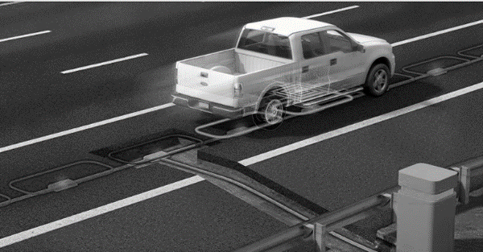
THERE ARE SEVERAL CHALLENGES TO IMPLEMENTING DYNAMIC CHARGING, INCLUDING THE NEED FOR INFRASTRUCTURE INVESTMENT TO INSTALL THE NECESSARY EQUIPMENT ON ROADS AND IN VEHICLES, AS WELL AS ENSURING SAFETY AND COMPATIBILITY WITH VARIOUS VEHICLE MODELS. HOWEVER, RESEARCH AND DEVELOPMENT IN THIS AREA IS ONGOING, AND THERE HAVE BEEN SUCCESSFUL PILOT PROJECTS AND DEMONSTRATIONS OF DYNAMIC CHARGING TECHNOLOGY IN VARIOUS COUNTRIES AROUND THE WORLD.

Slide 22
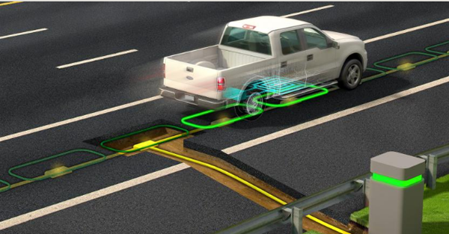

Slide 23
DISADVANTAGES
LONGER CHARGING TIMES
INCREASED ENERGY CONSUMPTION
EXPENSIVE TO INSTALL

Slide 24
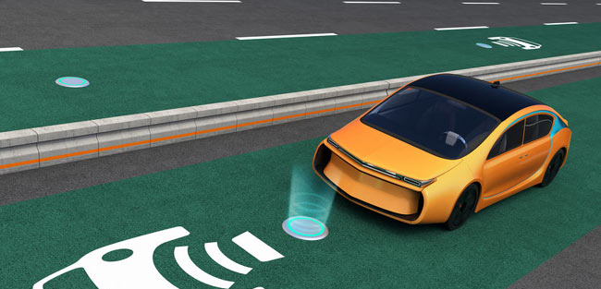
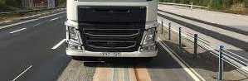
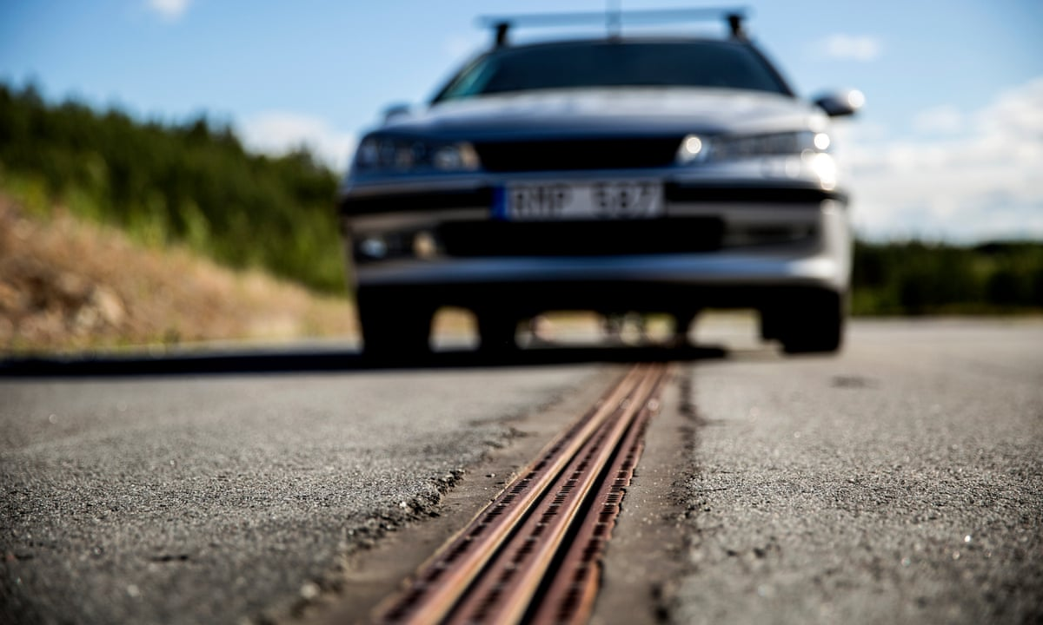
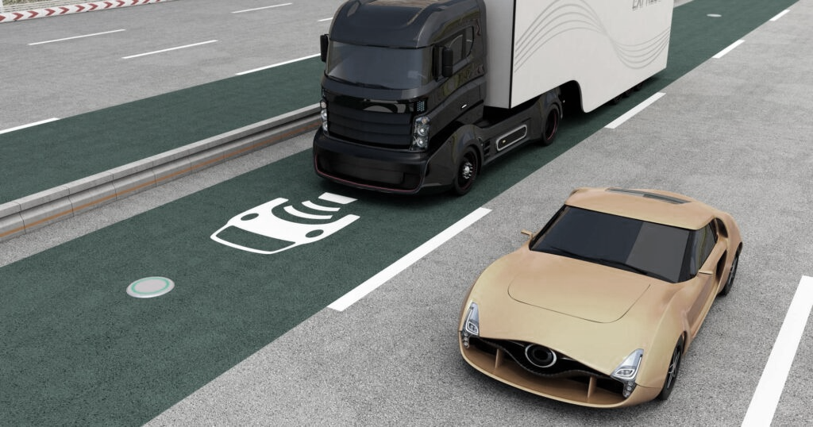
FUTURE WORKS
FUTURE WORKS:
THE INDIAN GOVERNMENT HAS SET AN AMBITIOUS TARGET TO ACHIEVE 100% ELECTRIC MOBILITY BY 2030
HYUNDAI AND KIA ARE CONSIDERING ON COMMERCIALIZING INDUCTIVE POWER TECHNOLOGY UPON THE LAUNCH OF LEVEL 4 AUTONOMOUS VEHICLE AROUND YEAR 2025.
IN SWEDEN, A PROJECT CALLED "EROADARLANDA" WAS LAUNCHED IN 2016, WHICH INVOLVED THE CONSTRUCTION OF AN ELECTRIC ROAD BETWEEN STOCKHOLM ARLANDA AIRPORT AND A LOGISTICS CENTER

Slide 25
ELECTRICAL REQUIREMENTS
Total electricity = R x 7 kW x 6-7 hours
For example, if you have 50 wireless charging pads in parking slots for cars and each pad is used for an average of 6 hours per day, then the total amount of electricity needed would be:
Total electricity = 50 x 7 kW x 6 hours = 2,100 kilowatt-hours (kWh) per day
COST
Using the average cost of 4.5 INR per kWh, the total cost of producing 21,000 kWh of electricity would be approximately 94,500 INR. However, it is important to note that this is only an estimate, and the actual cost could be higher or lower depending on a variety of factors.

Slide 26
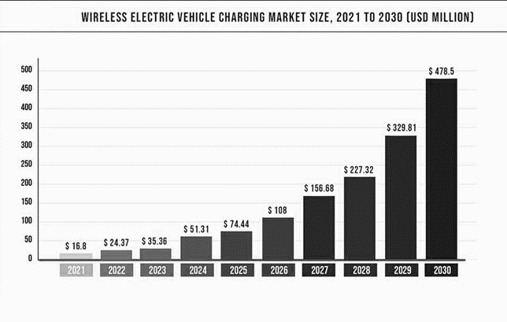
THE TECHNOLOGY IS STILL RELATIVELY NEW AND FACES SOME CHALLENGES IN TERMS OF EFFICIENCY, COST, AND RANGE. DESPITE THESE CHALLENGES, THE ADOPTION OF WIRELESS CHARGING SYSTEMS IS EXPECTED TO INCREASE AS THE TECHNOLOGY CONTINUES TO IMPROVE AND BECOME MORE AFFORDABLE.

Slide 27
Contributions
Idea:
Arnav Jain
Research:
Gayatri Puranik
Mahee Jain
Bhoomi Gupta
Shivendra Pratap Singh
Powerpoint presentation:
Sahil Prasoon
Samardeep Singh
Anushka Singh
Shreyash
Tanmay Tushar
Web Development:
Mahee Jain
Arnav Jain

